Slide 1
Touch Typing Course Part 4

Slide 2

Content
After finishing the lesson student will be able to:
Typing without watching their keyboard smoothly from letters A-Z
Keys G H and apostrophe
Keys V N and question mark
Keys W and M
Keys Q and P

Slide 3
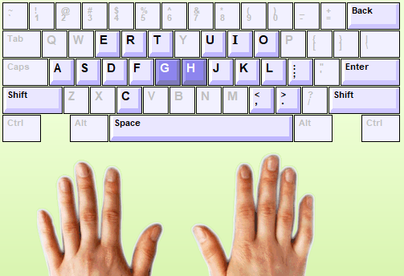
Keys G H and apostrophe
The keys G and H located on the same the home row. Key G and H are typed using the Index fingers.
Notes:
Desktop can’t move during using because no power supply
Laptop can move to everywhere because it has power supply

Slide 4
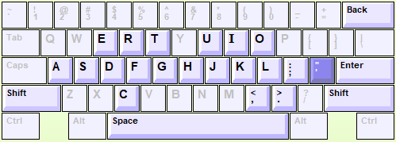
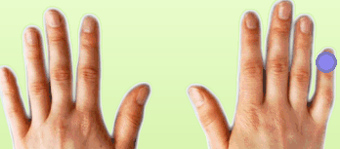
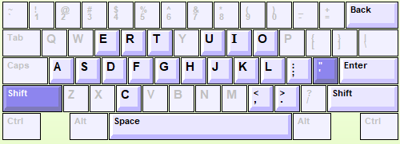
Keys G H and apostrophe
Single quote key is typed use right little finger.
Double quote key is typed use:
1). Hold Shift with left little finger
2). Press “ key with right little finger”
Notes:
Desktop can’t move during using because no power supply
Laptop can move to everywhere because it has power supply

Slide 5
Practice
1). Turn on your computer
2). Login into Typing Master with your account
3). Start to typing on “lesson seven= Keys G H and apostrophe”
New keys: G H= 5 min
Word drill = 2 time ( 4x2=8 min)
New keys: “ = 2 min
Word drill= 5min
Sentence drill= 5 min
Paragraph drill= 2 times (5x2=10min)
Lesson exam = 10min
Students follow with instruction from Teacher one by one.
Notes:
Let them do it

Slide 6
Practice
1). Turn on your computer
2). Login into Typing Master with your account
3). Start to typing on “lesson night= Keys W and M”
New keys: W M= 5 min
Word drill = 5 min
Bubbles game = 5 min
Word drill= 5min
Sentence drill= 5 min
Paragraph drill= 2 times (5x2=10min)
Lesson exam =10min
Students follow with instruction from Teacher one by one.
Notes:
Let them do it

Slide 7
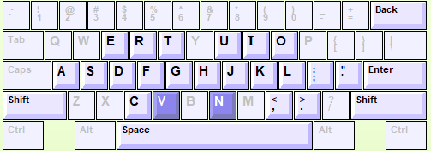
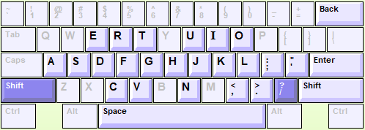
Keys V N and Question mark
The keys V and N located below the home row. V and N are typed using the Index Fingers.
The keys ? Located below the home row. ? Are typed using :
Hold Shift with left little ginger
Press “?” key with right little finger
Notes:
Desktop can’t move during using because no power supply
Laptop can move to everywhere because it has power supply

Slide 8
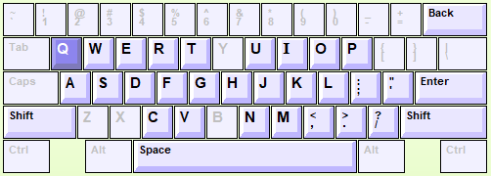
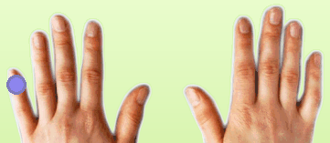
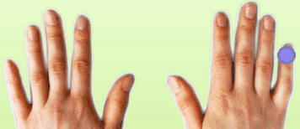
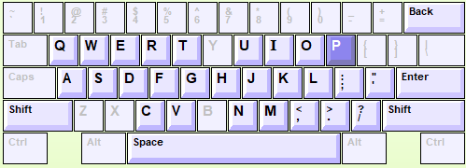
Keys Q and P
The keys Q located above the home row. Q typed using the left little Finger.
The keys P located above the home row. Q typed using the right little Finger.
Notes:
Desktop can’t move during using because no power supply
Laptop can move to everywhere because it has power supply

Slide 9
Practice
1). Continue to the next lesson Eight “ Keys V N and Question mark”
2). Start to typing with instruction below:
New keys: V N= 5 min
Word drill = 5 min
New keys: ? = 2 min
Word drill= 5min
Sentence drill= 5 min
Paragraph drill= 2 times (5x2=10min)
Lesson exam = 10min
Students follow with instruction from Teacher one by one.
Notes:
Let them do it

Slide 10
Practice
1). Continue to the next lesson Ten “ Keys Q and P”
2). Start to typing with instruction below:
New keys: Q P= 5 min
Word drill = 5 min
Wordtris = 5 min
Word drill= 5min
Sentence drill= 5 min
Paragraph drill= 2 times (5x2=10min)
Lesson exam =10min
Students follow with instruction from Teacher one by one.
Notes:
Let them do it

Slide 11
HOMEWORK
Student Need to finish home work both in chapter Seven and Eight in Typing Master before next session by complete “ Lesson Exam”.
If you not complete, you can’t continue to the next chapter.
So it mean you need to qualify with speed in 10 min:
Less 15 wpm = 45 ( can’t continue)
15-19 wpm= 50
20-24 wpm = 60
25-29 wpm = 70
30-34 wpm =80
35-39 wpm = 90
40 up wpm= 100
Note: Teacher can check all your record typing. Do your best!

Slide 12
HOMEWORK
Student Need to finish home work both in chapter Night and Ten in Typing Master before next session by complete “ Lesson Exam”.
If you not complete, you can’t continue to the next chapter.
So it mean you need to qualify with speed in 10 min:
Less 15 wpm = 45 ( can’t continue)
15-19 wpm= 50
20-24 wpm = 60
25-29 wpm = 70
30-34 wpm =80
35-39 wpm = 90
40 up wpm= 100
Note: Teacher can check all your record typing. Do your best!

Slide 13

Login to Typing Master by your account
Open lesson 8 and 10 “ Lesson Exam” in Typing Master
Your full score 40wpm= 100pts

Slide 14

Any Question ????

